Slide 1
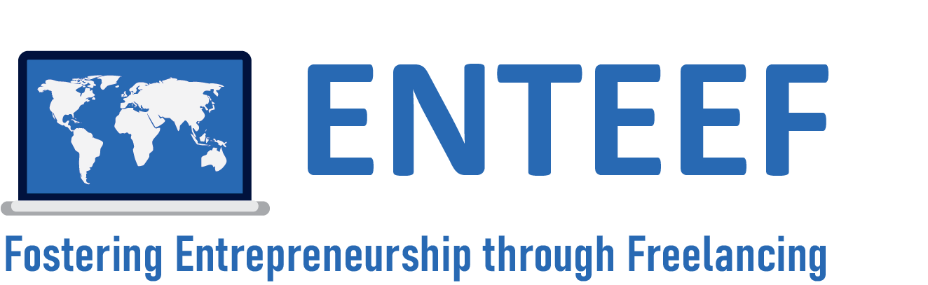



Freelancing as a Way of Life and Work
Notes:
Freelancing has been developing for many decades. And in recent years, it has become a frequent choice for the professional career of specialists in many fields

Slide 2
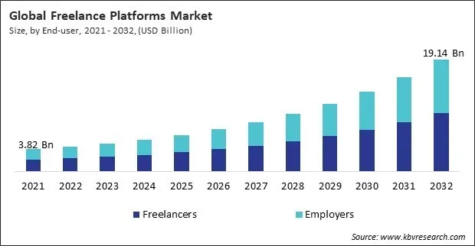
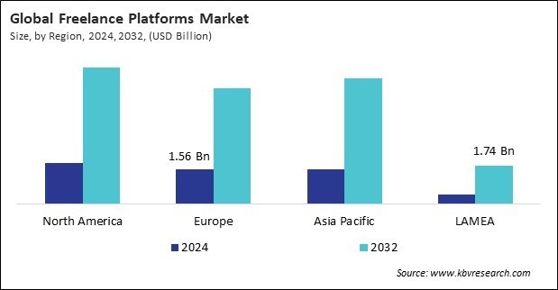
Rapid development of the freelancing market
Notes:
This form of employment is developing very dynamically. Forecasts indicate that the development trend will continue in the next decade and will grow. This development has a global character. The projected growth of the freelancing market will multiply by 2032.

Slide 3
Advantages of freelancing
Being your own boss
Flexible working hours
🧩
💼
Developing your skill set
Income from multiple sources
💵
🛠️
Working from anywhere
🏝️
But you must be ready to take the responsibility for yourself…
Notes:
Freelancing is seen as an attractive form of professional career, especially for people from younger generations. The most frequently mentioned advantages include:
Being boss of yourself,
control of one's own professional development path,
the ability to work from anywhere,
flexible working hours,
Income from multiple sources,
better work-life balance,
Undoubtedly, this is true, but there is also the other side of the coin. Being a freelancer requires effort.

Slide 4
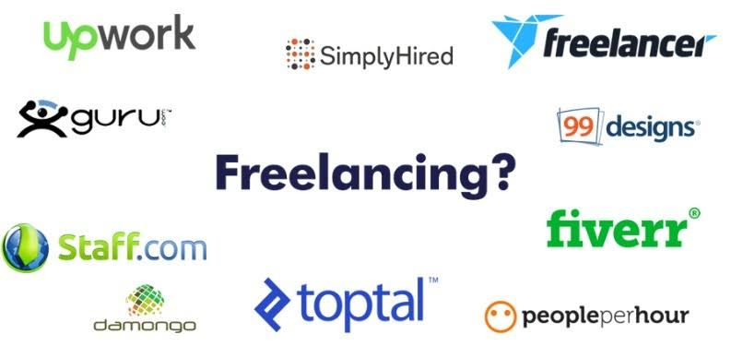
Competency Assessment Tool
Identified Competence Areas
Foundations of Freelancing and Entrepreneurship
Project Planning and Delivery (Project Management)
?
Building a Strong
Professional Identity
Client Acquisition and Relationship Building
Self-improvement
Continuous Learning and Professional Growth
Personal Effectiveness and Resilience (Self-Management)
Notes:
Skills in the field in which a freelancer works are treated as basic and obvious today. They are also easy to verify, either by verifying them during the interview or through references. But these skills are not everything. The ENTEEF research points to numerous additional skills that are crucial in a freelance career. We have grouped these skills into six basic areas:
Foundations of Freelancing and Entrepreneurship,
Project Planning and Delivery (Project Management),
Building a Strong Professional Identity,
Client acquisition and relationship building,
Continuous Learning and Professional Growth.
Personal Effectiveness and Resilience (Self-Management).
Two MOOCs have been prepared for each of these areas. Their goal is to increase the competence of a freelancer in a given area. To make it easier to choose courses, we have proposed the Competency Test (CAT). It will allow you to identify those areas in which it is worth investing your time. The same tool can be used to assess progress after completing courses.
Each of the courses is scheduled for 12 hours, and completion is confirmed by a certificate. The participant can obtain a micro-credential giving half an ECTS credit.

Slide 5




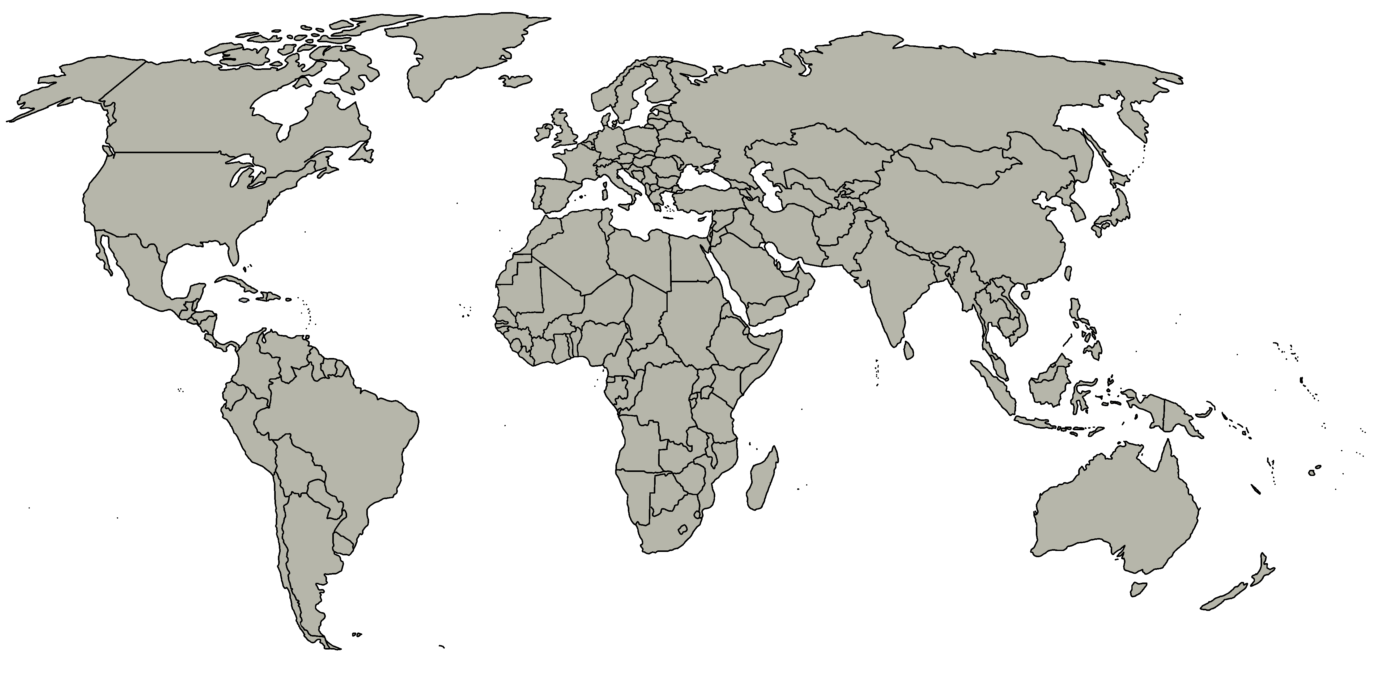








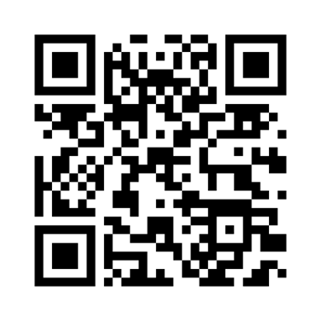
ENTEEF global partners
Notes:
The research and courses were carried out by an international consortium within the ENTEEF project (part of the Erasmus+ programme). The consortium consists of six universities from five European countries: Spain, Poland, Romania, Serbia and Ukraine, as well as Indonesia, representing Asian countries. The leader of the consortium is the Krakow University of Economics from Poland.

